Slide 1
Lane Line Finding Project
By: Cody Nicholson & Merga Tafa
Notes:
together

Slide 2
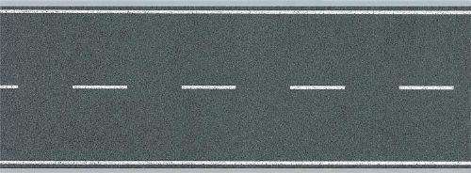
Outline
Abstract
Problem Statement & Motivation
Related Work
Methodology
Conclusion
References
Questions
Notes:
merga

Slide 3
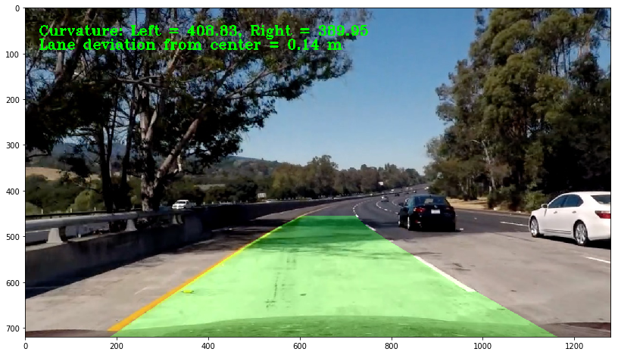
Abstract
We created a program to detect lane lines in front of a moving vehicle. We did this by correcting distortion caused by the camera lens, using color transformations and gradients to create a thresholded binary image, applying a perspective transformation to turn our image into a top-down view, detecting lane pixels and fitting them to find the lane boundary, determining the curvature of the lane and vehicle position with respect to center, warping the detected lane boundaries back onto the original image, and outputting a visual display of the lane boundaries with the numerical estimation of lane curvature and vehicle position included in the image.
Notes:
cody

Slide 4
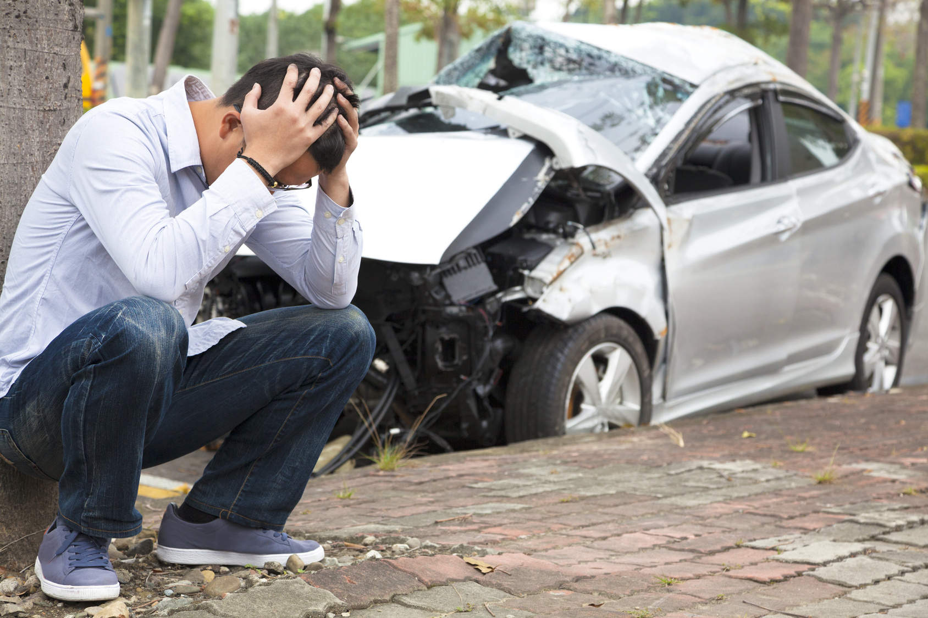
Problem Statement & Motivation
Over 30,000 people are killed in auto-related accidents each year in the United States alone. Save for a few outliers, the vast majority of these accidents can be attributed to human error.
What if we could create programs to detect and avoid these accidents with a lower error rate than humans? To this end, we created a program to detect lane lines in front of a moving vehicle. We hope that our research will benefit future endeavors to prevent auto-related accidents.
Notes:
merga

Slide 5
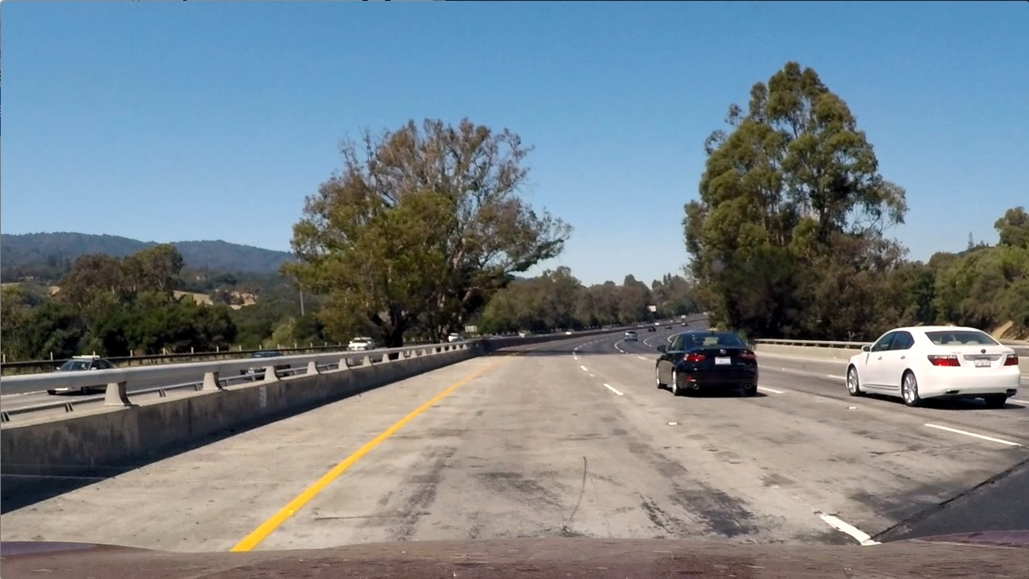
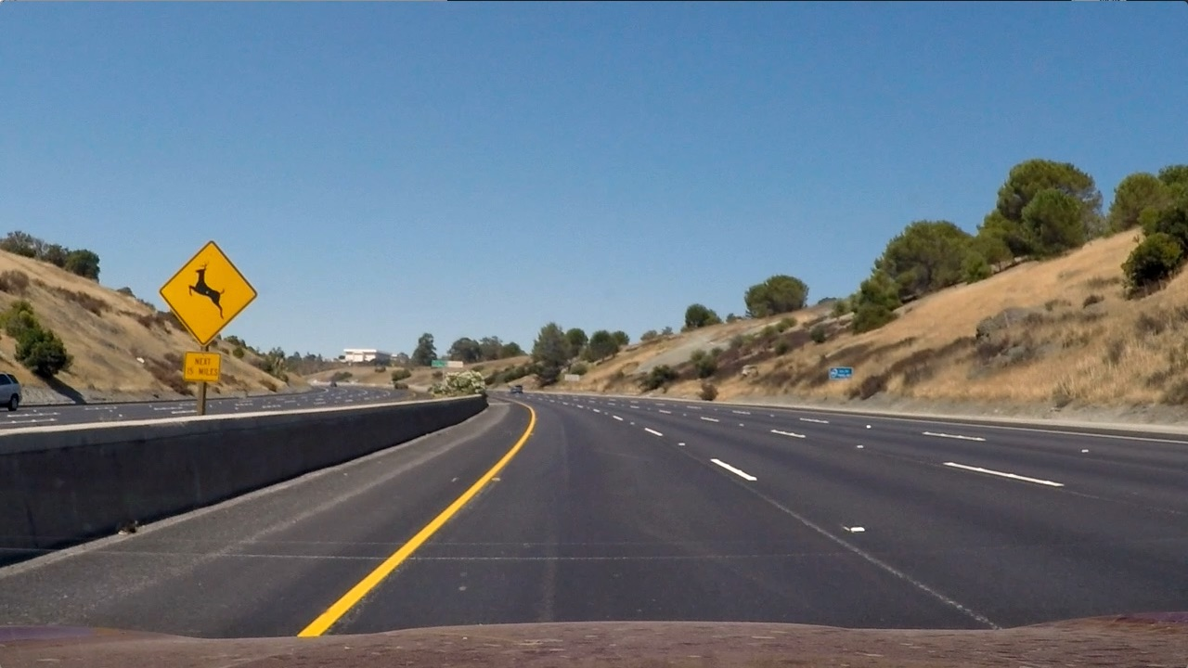
Data Collection
We found our test image dataset on kaggle. The test images are all taken with a camera lens that distorts the image slightly because of the lens. The roads are different colors in different images, and the surroundings are always different. The camera is always in the same position on the front of the car for all images.
Notes:
Merga

Slide 6
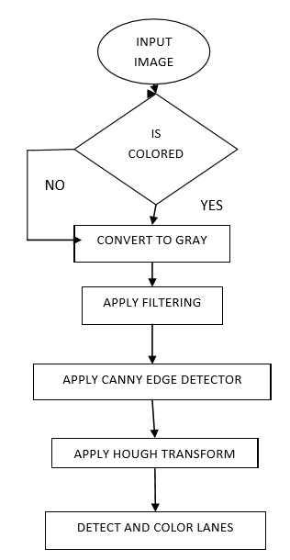
Paper 1: Lane Detecting techniques: A review
The main purpose of this paper is to detect lane markings and localizing any road markings. To achieve this goal, the edge detecting method is used to convert and segment those markings from RGB into binary images so that those markings of the edge can be seen as their intensity changes.
In a similar way, we made color transformation for lanes marking by creating a thresholded binary image to differentiate their color channel.
Notes:
Merga - This paper taught us about a workflow that we could use to identify lane lines in our images. As you can see in the image, our input images go through these steps to segment the lane lines.

Slide 7
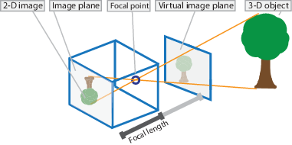
Paper 2: Camera Calibration with Distortion Models and Accuracy of Evaluation
According to this research paper, camera calibration is the essential task to measure the dimensions of the images as image coordinates (pixels) determine the exact position of camera and the points of interest of any scenes of image. The aim is to eliminate distortion of image points from their positions . One of the techniques used to find image points distortion is the projection of coordinates from 3-D of image plane projection and then iterative algorithms applied to detect the distortions.
Similarly, we used a chessboard to project coordinates of points from image in the form of (x, y, z) coordinates to adjust the distorted coordinates and applied some functions from algorithms to compute the calibration of the camera.
Notes:
Merga - Our images were distorted by the camera lens used to take them. The camera lens left a curves texture on our images, so we read this paper to learn how to undistort our images. The image in the top-right shows you how distortion can happen in an image.

Slide 8
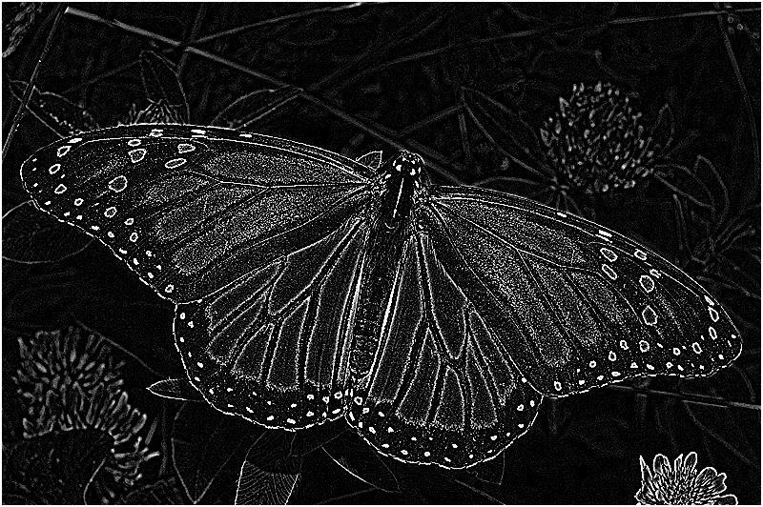
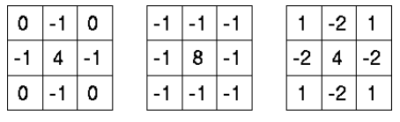
Paper 3: Structure-Preserving Color Transformations using Laplacian Commutativity
This paper gave us lots of examples of how Laplacian filters can be used to detect edges in images using derivatives. For this kind of filter, the edges will be detected if there is rapid change in in the color values at any point in the image.
After learning that the Laplacian filter has trouble dealing with noise, we decided that the Sobel Gx filter would be a better fit for the edge detection in our project.
Notes:
Cody - Our third paper was all about the Laplacian filter that we learned here in class. After experimenting with this filter, we decided not use this filter since it does not respond well to the noise that is found in out images.

Slide 9
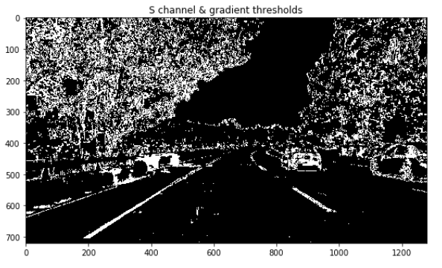
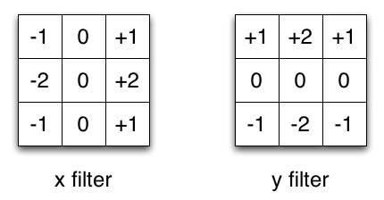
Paper 4: Study Sobel Edge Detection Effect on the Image Edges Using MATLAB
In this paper, the main goal is to inform the reader of how to implement edge detection techniques used on digital images. Edge detection methods can be applied in different ways to digital images. One method is the Sobel method of edge detection. The sobel method combines the horizontal and vertical masks as well as matrices to detect the maximum and minimum pixels to detect edges.
Since the lane lines are vertical relative to the driver, we used a Sobel_x filter to find the edge based on the brightest pixels in a vertical line.
Notes:
Cody - In our fourth paper we learned how to apply the Sobel filter to our images. We chose to use the Sobel X filter since our lane lines are bright vertical lines in our image. The Sobel x filter is made for detecting edges just like this.

Slide 10
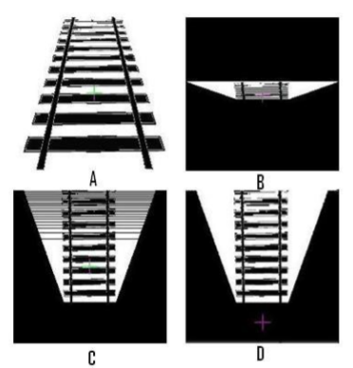
Paper 5: Transformation Techniques
This paper was all about changing the perspective of an image from a forward-facing one to a top-down perspective. In an image taken from a forward-facing perspective, it is hard to make out the objects near the top of the image since they are farther away. By stretching out the image in the farther away parts, we can get a better picture of what is going on in the image.
In our project we used this to identify lane lines that were farther away in the image. It was much easier for our program to process when the image was transformed into a top-down perspective.
Notes:
Merga - In this paper we learned how to warp our images to change the perspective from forward facing to top-down. This top-down perspective made it much easier for our program to segment the lane lines from the images and perform calculations. As you can see in the image, the railroad changes from a forward-facing perspective to a top-down perspective.

Slide 11
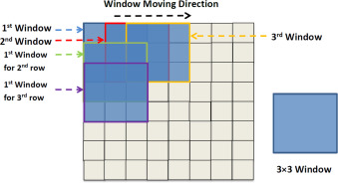
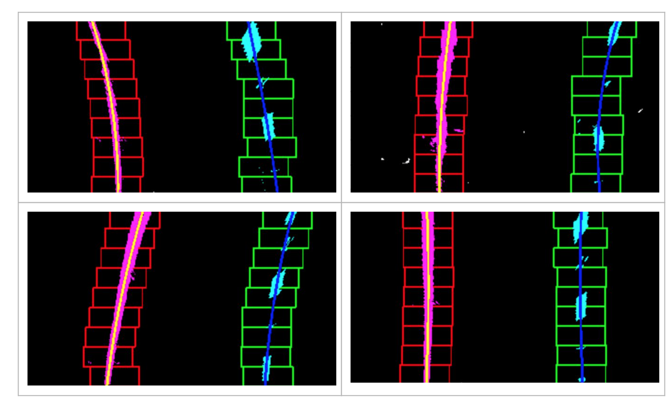
Paper 6: Sliding window approach based Text Binarization from Complex Textual images
This paper processed and classified individual pixels as text or background in textual images. The sliding window method is used to binarize text from textual images with textured background after the images are preprocessed. The results show that the proposed method is an effective method and outperforms the other methods in the complex/textured background situation.
We utilized the sliding window method in our project to collect all of the indices of lane line pixels in our images. By collecting all of these indices, we were able to relate each lane line pixel to the other lane line pixels to form the complete lane line.
Notes:
Cody - Our sixth and final paper was about how to apply the sliding window approach to our binary images. As you can see in the top image, the sliding window approach parses through the image to find vrious features of the image. In our case, we wanted to find the bright lane line pixels. As you can see in the lower image, our windows detected the lane lines and we can now use segment the entire lane line from the image.

Slide 12
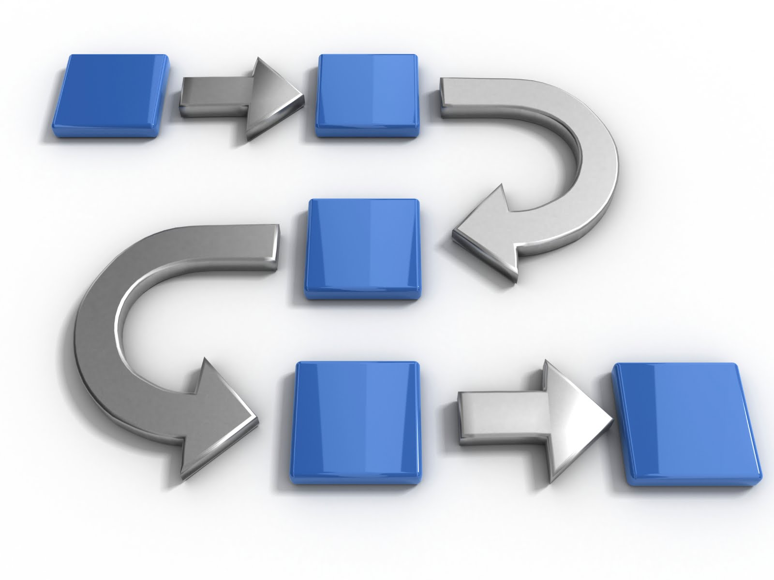
Methodology
Fix distortion caused by camera lens in images
Use color transforms and gradients to create a thresholded binary image
Apply a perspective transform to the binary image to change it to top-down view
Detect lane pixels and fit them to find the lane boundary
Output visual display of the lane boundaries
Notes:
merga

Slide 13
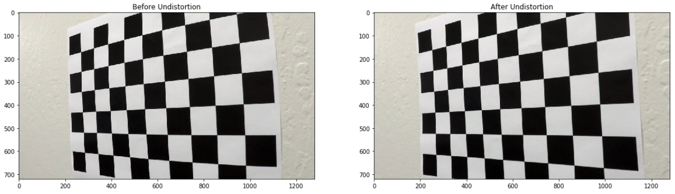
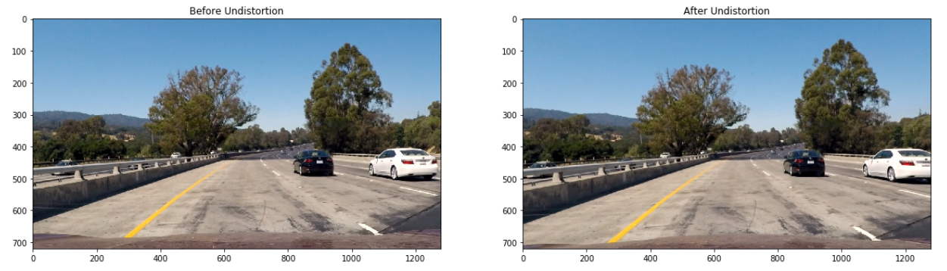
Compute the camera calibration matrix and distortion coefficients given a set of chessboard images
The round glass of the lens of the camera used to take our images causes distortion. Finding the corners of the chessboard images taken with the same lens allowed us to undistort the images; Since we know there should be a straight line between each corner and the adjacent corners.
We accomplished this using the Computer Vision functions: findChessboardCorners(), calibrateCamera(), and undistort().
Notes:
Merga - In the top-left image you can see that the chessboard is slightly curved. To fix this, we used computer vision to identify the corners of the chessboard image, and we used those corners as a reference to undistort the image. We then applied this undistortion to our lane line images. As you can see in the image on the top left, the lines are not straight up and down.

Slide 14
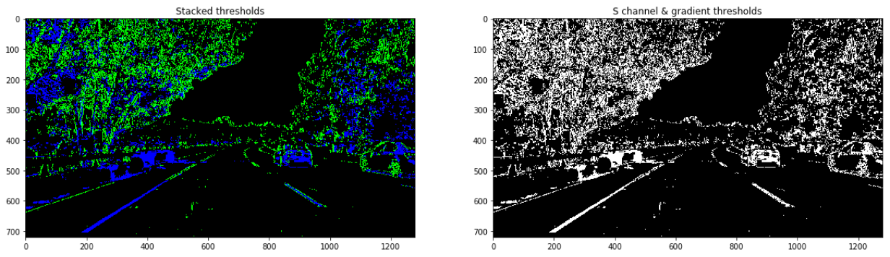
2. Use color transforms and gradients to create a thresholded binary image
We used a combination of color and gradient thresholds to generate a binary image. Separating the image into different color channels helps because we want to look at the color channel that defines the lane lines the best. In the program, we used the color channel 's'.
Notes:
Cody

Slide 15
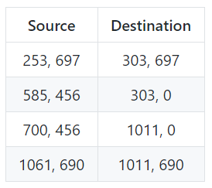
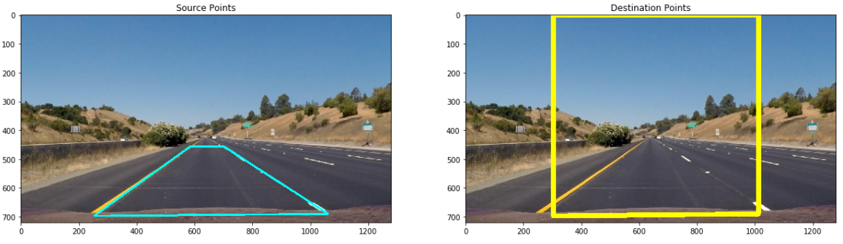
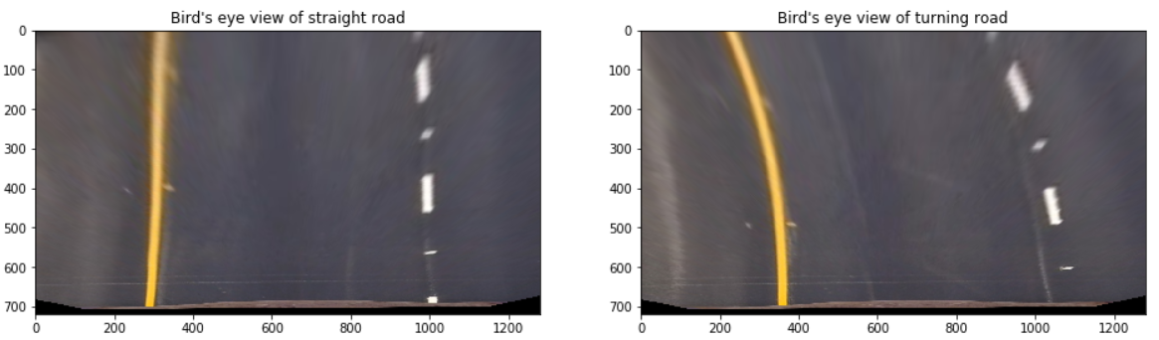
3. Apply a perspective transform to our binary image by changing to top-down view
We used a perspective transform to change the forward-facing images into a top-down perspective. This was done so that we could have better accuracy when identifying lane lines. We verified that the perspective transform was working as expected by drawing the source and destination points onto a test image and its warped counterpart to verify that the lines appear parallel in the warped image.
Notes:
Cody - Our third step was to apply a perspective transform to our image. As you can see in the center image, we define source and destination points in our images. We then streach these sections of the image to create a top-down view of the lane line. This was much easier for our program to process than the original image.

Slide 16
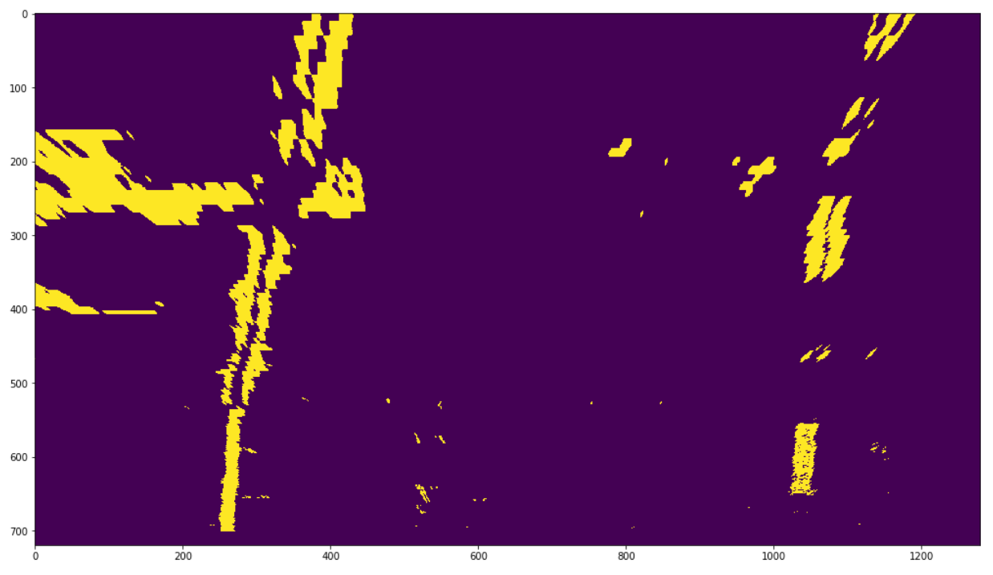
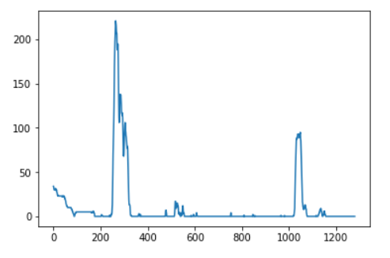
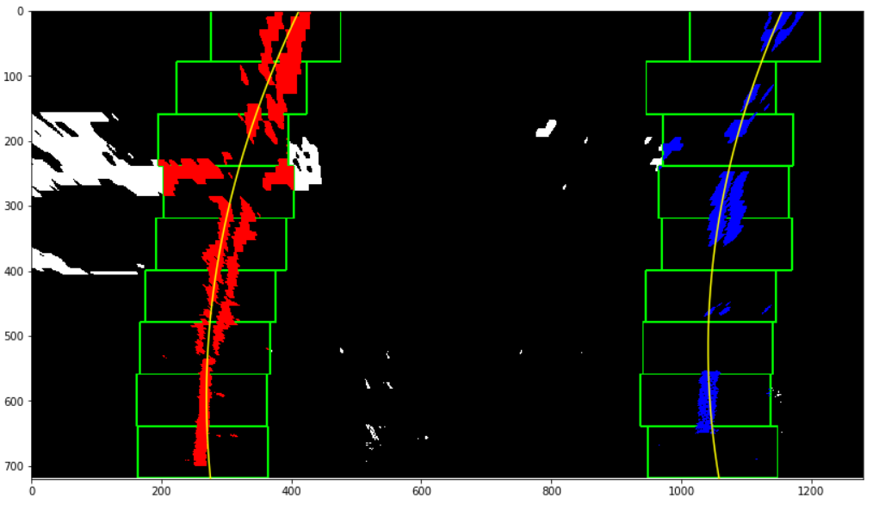
4. Detect lane pixels and fit them to find the lane boundary
We used a histogram to identify the lanes in the picture. The histogram graphed the places in the image where there was the brightest and most complete lines.
After identifying the lane lines (the peaks in the histogram), we then set the number of sliding windows that will localize exactly where in the image the lane lines reside.
We then slide the windows over the image collecting the indices for each lane line in an array. Then we fit these indices and move on to working with the curvature of the lane lines.
Notes:
Cody - Our fourth step was to use histogram equalization to find the places in our image where the brightest pixels were located. In the top right image you can see the histogram of the top left image where the peaks in the image clearly tell where the lane lines are located. We then used our sliding window method to parse through the image to find the lane lines as you can see in the bottom image. We were even able to capture the curvature of the lane line accurately using some math.

Slide 17
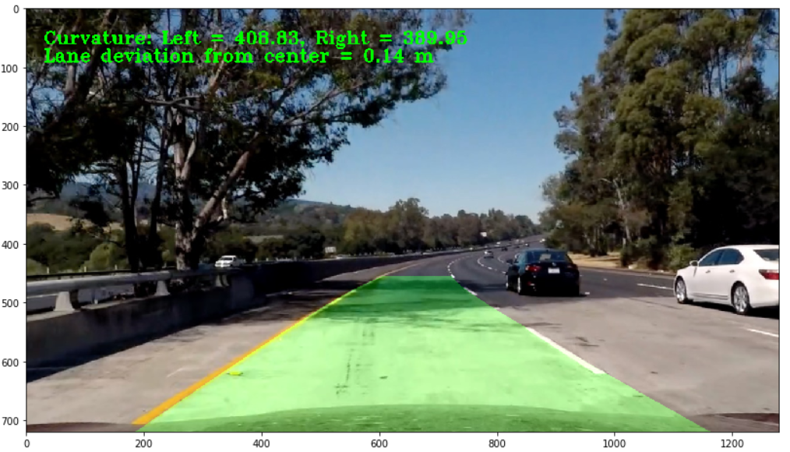
5. Warp the detected lane boundaries back onto the original image and output visual display of the lane boundaries
This image represents the preliminary result of our implementation plotted back down onto the road such that the lane area is identified clearly. You can see the calculations in the upper left-hand corner.
Notes:
Merga - In this image we put all of the techniques we used together to produce the preliminary result of our implementation. We put some of our calculations used in our program in the upper left-hand corner.

Slide 18

Evaluation/Interpretation/Conclusion
We learned a lot in completing this project. We got to experiment with computer vision, become more familiar with linear algebra, and become better at programming in python.
Our implementation is not perfect by any means. It does have high accuracy, but it has problems when the color of the road changes quickly. This may happen when moving from an asphalt road to concrete. If we had more time we would work on our thresholding more to eliminate this problem.
While we would not recommend this for use by any person or vehicle just yet, it is a step in the right direction for the initiative to improve safety on our roadways.
Notes:
cody

Slide 19
References
Kaur, Gurveen. "Lane Detection Techniques: A Review." DAVIET College, Jalandhar (Pb.) India, 10 February 2015, http://research.ijcaonline.org/volume112/number10/pxc3900923.pdf.
Weng, Juyang. "Camera Calibration with Distortion Models and Accuracy of Evaluation." Institute of Electrical and Electronics Engineers , 10 October 1992, http://ieeexplore.ieee.org/document/159901/.
Eynard, D. "Structure-preserving color transformations using Laplacian commutativity." University of Lugano, Switzerland, 1 November 2013, https://arxiv.org/pdf/1311.0119.pdf/.
Mohammad, Elham. "Study Sobel Edge Detection Effect on the Image Edges Using MATLAB." International Journal of Innovative Research in Science, India, March 2014, https://www.ijirset.com/upload/2014/march/68_Study.pdf/.
Venkatesh, V. "Transformation Techniques." International Journal of Scientific & Engineering Research, 5 May 2012, https://github.com/CodyNicholson/Lane_Line_Finding_Project/raw/master/pdfs/Simple_Birds_Eye_View_Transformation_Technique.pdf/.
Lee, Han-Wook. "Sliding window approach based Text Binarization from Complex Textual images." International Journal on Computer Science and Engineering, IJCSE, 18 March 2010, https://arxiv.org/abs/1003.3654.
Notes:
merga

Slide 20
Thank you for your attention! Any questions?
Notes:
together

